Slide 1
Tack
Notes:
This section introduces parts of the saddle and bridle in preparation for learning how to tack up.

Slide 2
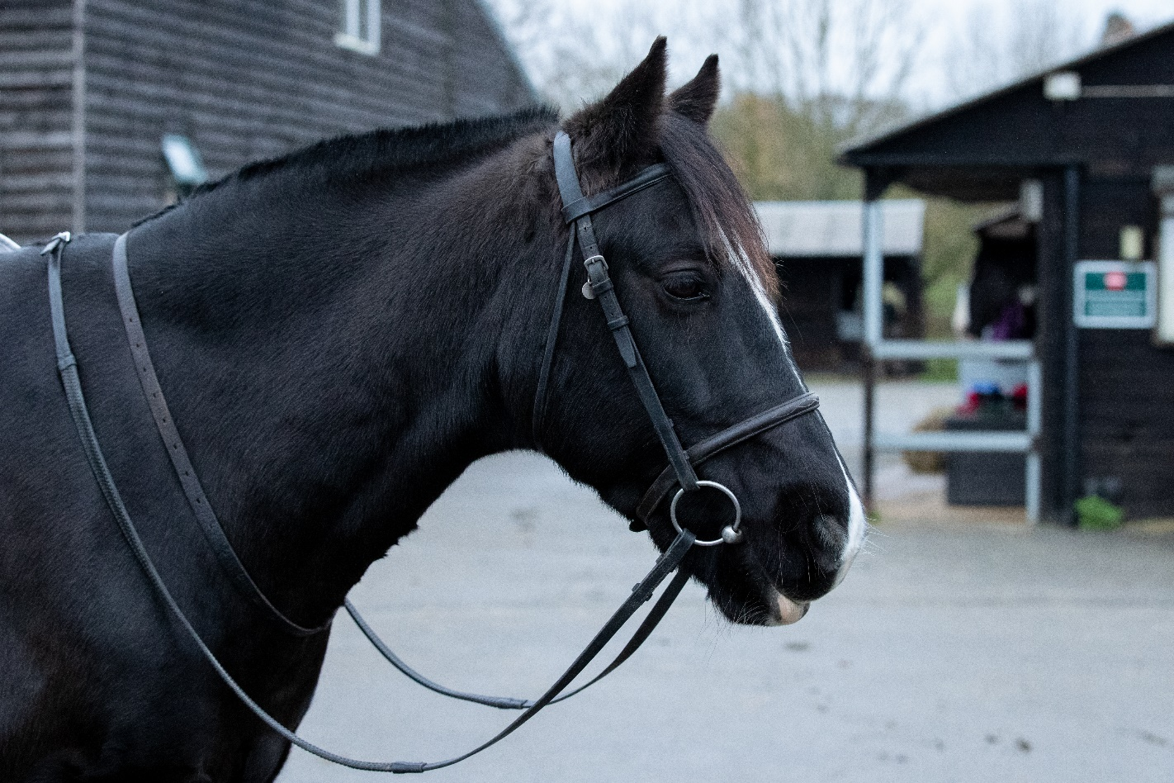
Parts of the bridle
Browband
Cavesson noseband
Reins
Cheekpieces
Bit
Notes:
Explain to the group that there are many types of bridle, the one pictured is a simple snaffle bridle with a cavesson noseband (and is the same picture as in the booklet)
Ask the group if they recognise any parts and talk briefly about what each part does
If possible take in a snaffle bridle so participants can see one

Slide 3
Parts of the saddle
Seat
Saddle cloth
Stirrup iron
Stirrup leather
Saddle flap
Girth
Notes:
Explain to the group that there are different types of saddle, the one pictured is the same picture as in the booklet
Ask the group if they recognise any parts
If possible take in a saddle so participants can see one
Although the saddle cloth isn’t a part of the saddle the label has been included for information! Explain the use of a saddle cloth and the various names they might hear.

Slide 4
Parts of the saddle
Saddle flap
Knee roll
Thigh roll
Girth straps
Girth buckles
Notes:
Underside of the saddle

Slide 5
Quick quiz
List three parts of the bridle
List three parts of the saddle
Notes:
This quiz is very informal and is not designed to be a test. Answers can be written or verbal and there is space to write the answers in the booklet.
Any 3 parts of thebridle covered in the session
Any 3 parts of the saddle covered in the session

Slide 6
Congratulations you have completed Horse Knowledge part two

Slide 7
Notes:
This slide has been left blank for you to complete id required about the next steps for the group e.g. Bronze About the Horse Awards

