Slide 1

Ride Safe
Training the Trainers

Slide 2
Suggested Programme
Time | Venue | Activity
8.30 | Classroom | Arrive
8.45 | Classroom | Ride Safe Trainer Award Overview
10.00 | Arena (Indoor or outdoor) | Practical work on simulated route and riding in a group
11.00 | Road route | Walk road route
11.30 | Road route | Observe riders on road route
12.15 | Classroom | Q & A
12.30 | Leave

Slide 3
Ride Safe Trainer Award
All coaches that wish to deliver training for Ride Safe and sign off the Silver Ride Safe Challenge booklet MUST hold the Ride Safe Trainer Award.
This is a new qualification that supports coaches in the delivery of training and assessing the Ride Safe Bronze and Silver Challenge/Explorer Award.
This award will become part of the learning for the Stage 3 Coaching unit.

Slide 4

Resources for Trainers
On the APC Hub there is a link to a hidden webpage on the Bookshop to purchase all the Challenge Awards.
Make use of the bulk buy discounts
If your rider is an active member with the
BHS and would like to progress up the
professional pathway please let us know
when they achieve this award.
Once the information is sent into the office any
outstanding professional certificates will be sent out.
Notes:
On the Accredited Professional Hub there is a link to a hidden webpage on the Bookshop where you can purchase all the different types of Challenge Awards. Make use of the bulk buy discounts and get your order sent out the day after (orders made before 2pm daily Mon-Fri). On the bookshop now you will also get all the resources you need to deliver the course, including the certificate, there is no delay in giving your participants the recognition they deserve.
If your participant is an active member with the BHS and would like to go onto the professional pathway at any point, please let us know your successes! There is a link on the accredited professional hub that you can use to submit this information to us. We only need to know if they have been successful in the Silver Ride Safe Award or completed the Silver Awards in full.
Once the information is sent into the office any outstanding professional certificates will be sent out week after.

Slide 5
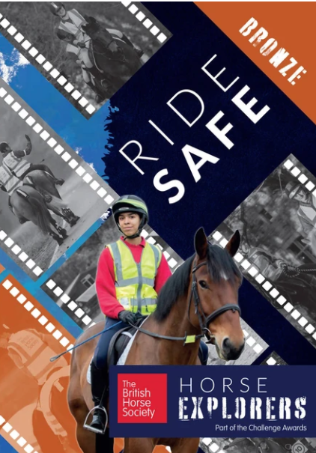

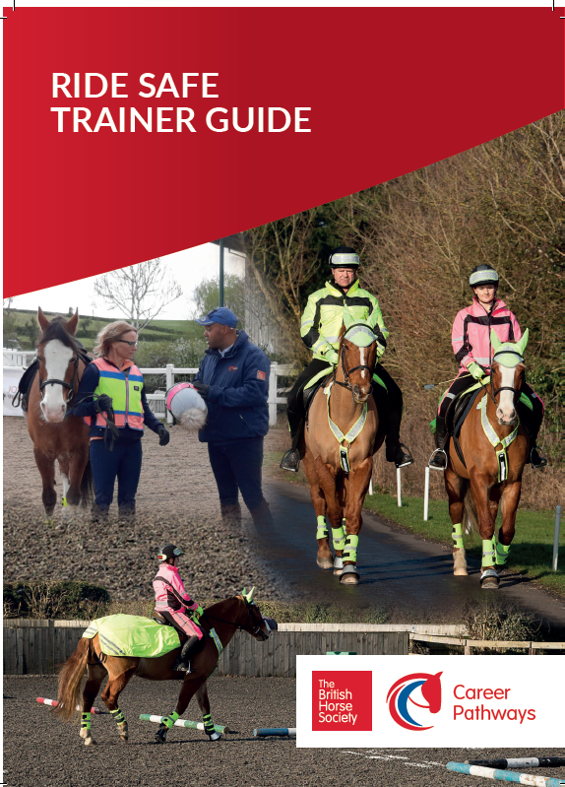


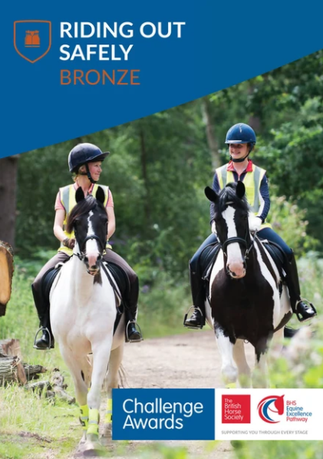
Ride Safe Trainer Guide
OR
Notes:
The Ride Safe Trainer Guide has been created to support you through your training of riders for the Bronze and Silver Ride Safe Challenge Award.
It should be used in conjunction with the Ride Safe Guide and the relevant Challenge Award/ Explorer booklets.
The rider packs can be bought from the BHS online shop and there is considerable saving to be had by buying in bulk – these can be mixed with other Challenge Award booklets..
https://www.britishhorseshop.com/collections/pony-stars-awards-resource/products/ride-safe-pack?variant=39573926183011

Slide 6
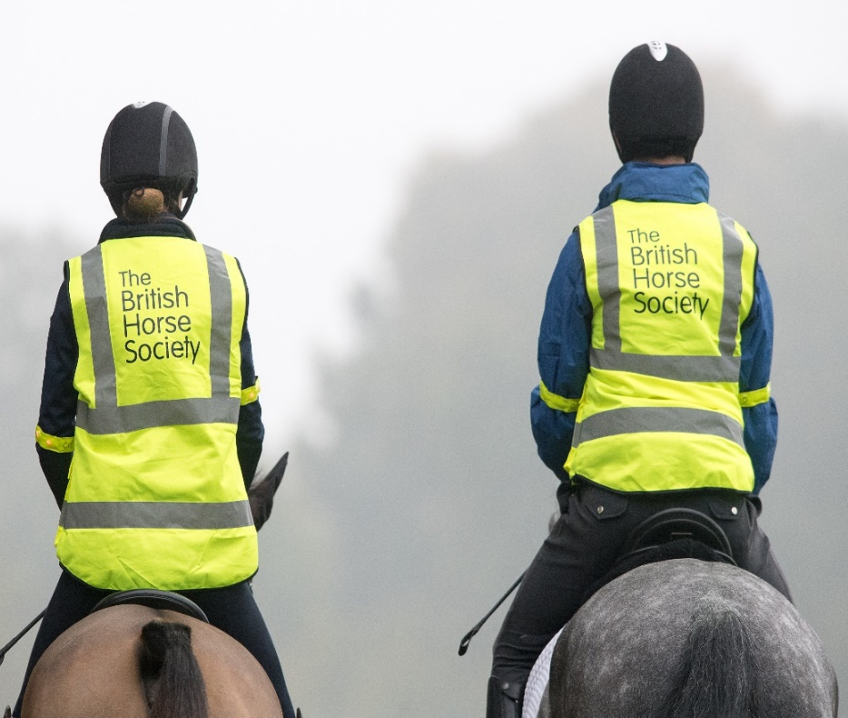
Who is it aimed at?
Every coach that intends to prepare riders for riding safely both on the road and in every other environment.
Anyone delivering the Ride Safe Challenge Awards.
Coaches who want to sign off the Ride Safe Silver Challenge Award
All riding school staff that take pupils out hacking or in other external environments

Slide 7
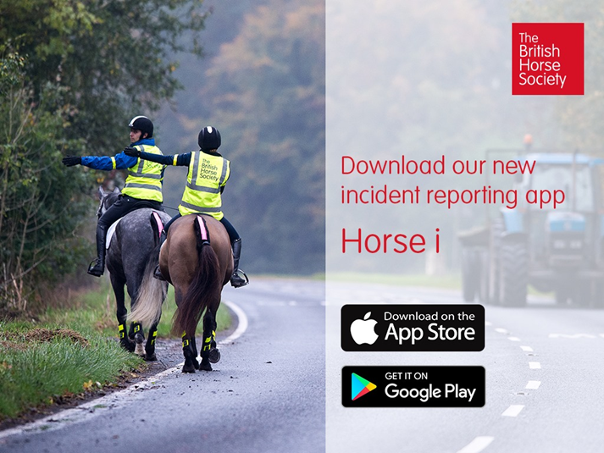
Download and use the HORSEi App!
Please encourage ALL your clients to download the App
Report all incidents – regardless of outcome.
The BHS can’t drive change without supporting statistics!
Notes:
Our Safety team are working incredibly hard to reduce the statistics of horse and rider injuries and fatalities on the road. We can only continue to lobby the local authorities and government if we have figures that reinforce our messages. So for every moment that you feel you were put in danger by an external force – please record it and help us to make riding on the roads safer for us all.

Slide 8
Course Structure
Introduction
Training Aim 1 – Establishing background knowledge
Training Aim 2 – Training riders to ride safely in a group
Training Aim 3 – Developing skills in a simulated environment
Training Aim 4 – Training riders to ride safely on the road
Training Aim 5 – Sign off and award the Ride Safe Bronze and Silver Challenge Award
Training Aim 6 – Review own training

Slide 9

Introduction
You will receive a numbered certificate with an expiry date.
You will need to do a refresher course every 3 years.
Notes:
Upon completion the coach will receive a numbered certificate of attendance with an expiry date.
You will need to do a refresher course every 3 years to ensure you are up to date with latest road regulations and we can keep you up to date with any latest road statistics. It also gives us a chance to discuss what we have been hearing from riders and what they want to achieve within these sessions.
The BHS has had a huge involvement over the years to make riding (particularly on the roads) safer for all riders, horses and other users.
Statistics on accidents on the roads (Alan), and increase on number of cars over past 10 years.
Dead slow, driver awareness and training, now our responsibility to educate ALL horse riders.
Introduce concept of the Ride Safe Silver Challenge Award Mention Bronze, Gold, Platinum Ride Safe, Challenge Award workbook

Slide 10

Training Aim 1 -establish Riding and Road Safety knowledge of coach
Technical competence of riding safely on and off the road
Coaches must hold the Ride Safe Award/ Ride Safe Silver Challenge Award OR the BHS Riding and Road Safety test.
They should hold the BHS Stage 2 Coach qualification OR have experience in the field of Riding and Road Safety.
Knowledge must be CURRENT and RELEVANT
XXXXXXXXX
xxxxxxxxxxxxxxxx
Notes:
As a coach, whilst your technical competence will already have been assessed when you achieved your Ride Safe or Riding and Road Safety qualification, the Ride Safe Trainer Award qualification will assess how you make use of those skills in the facilitation of effective training sessions for others. It would be useful to refresh yourself on the contents of the Highway Code and Countryside code as it applies to horses and Riders.

Slide 11
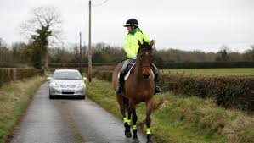
Crucial 4 steps
For every movement on the road, riders should follow these steps
Look behind
Signal
Halt (if necessary)
Life saver look before moving off

Slide 12
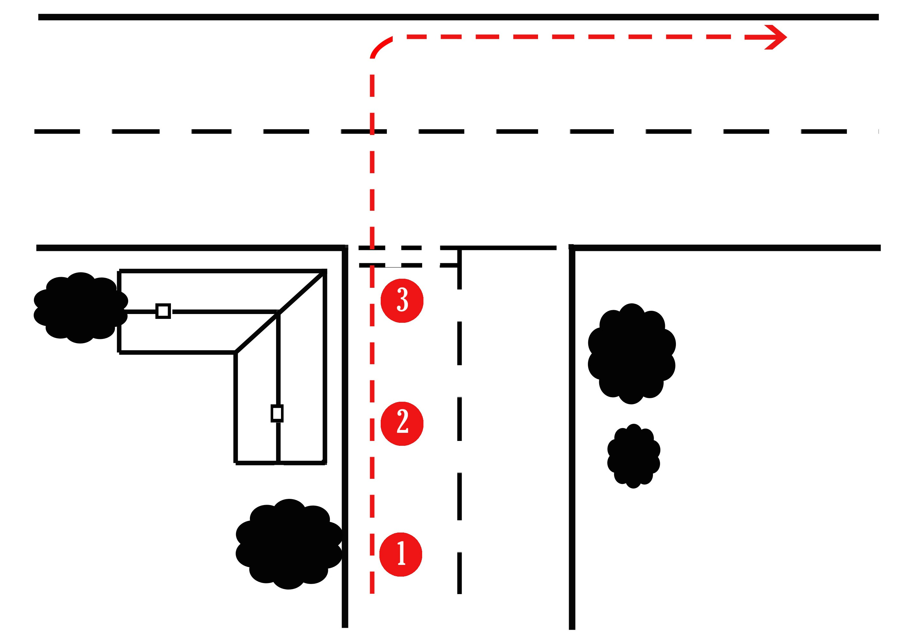
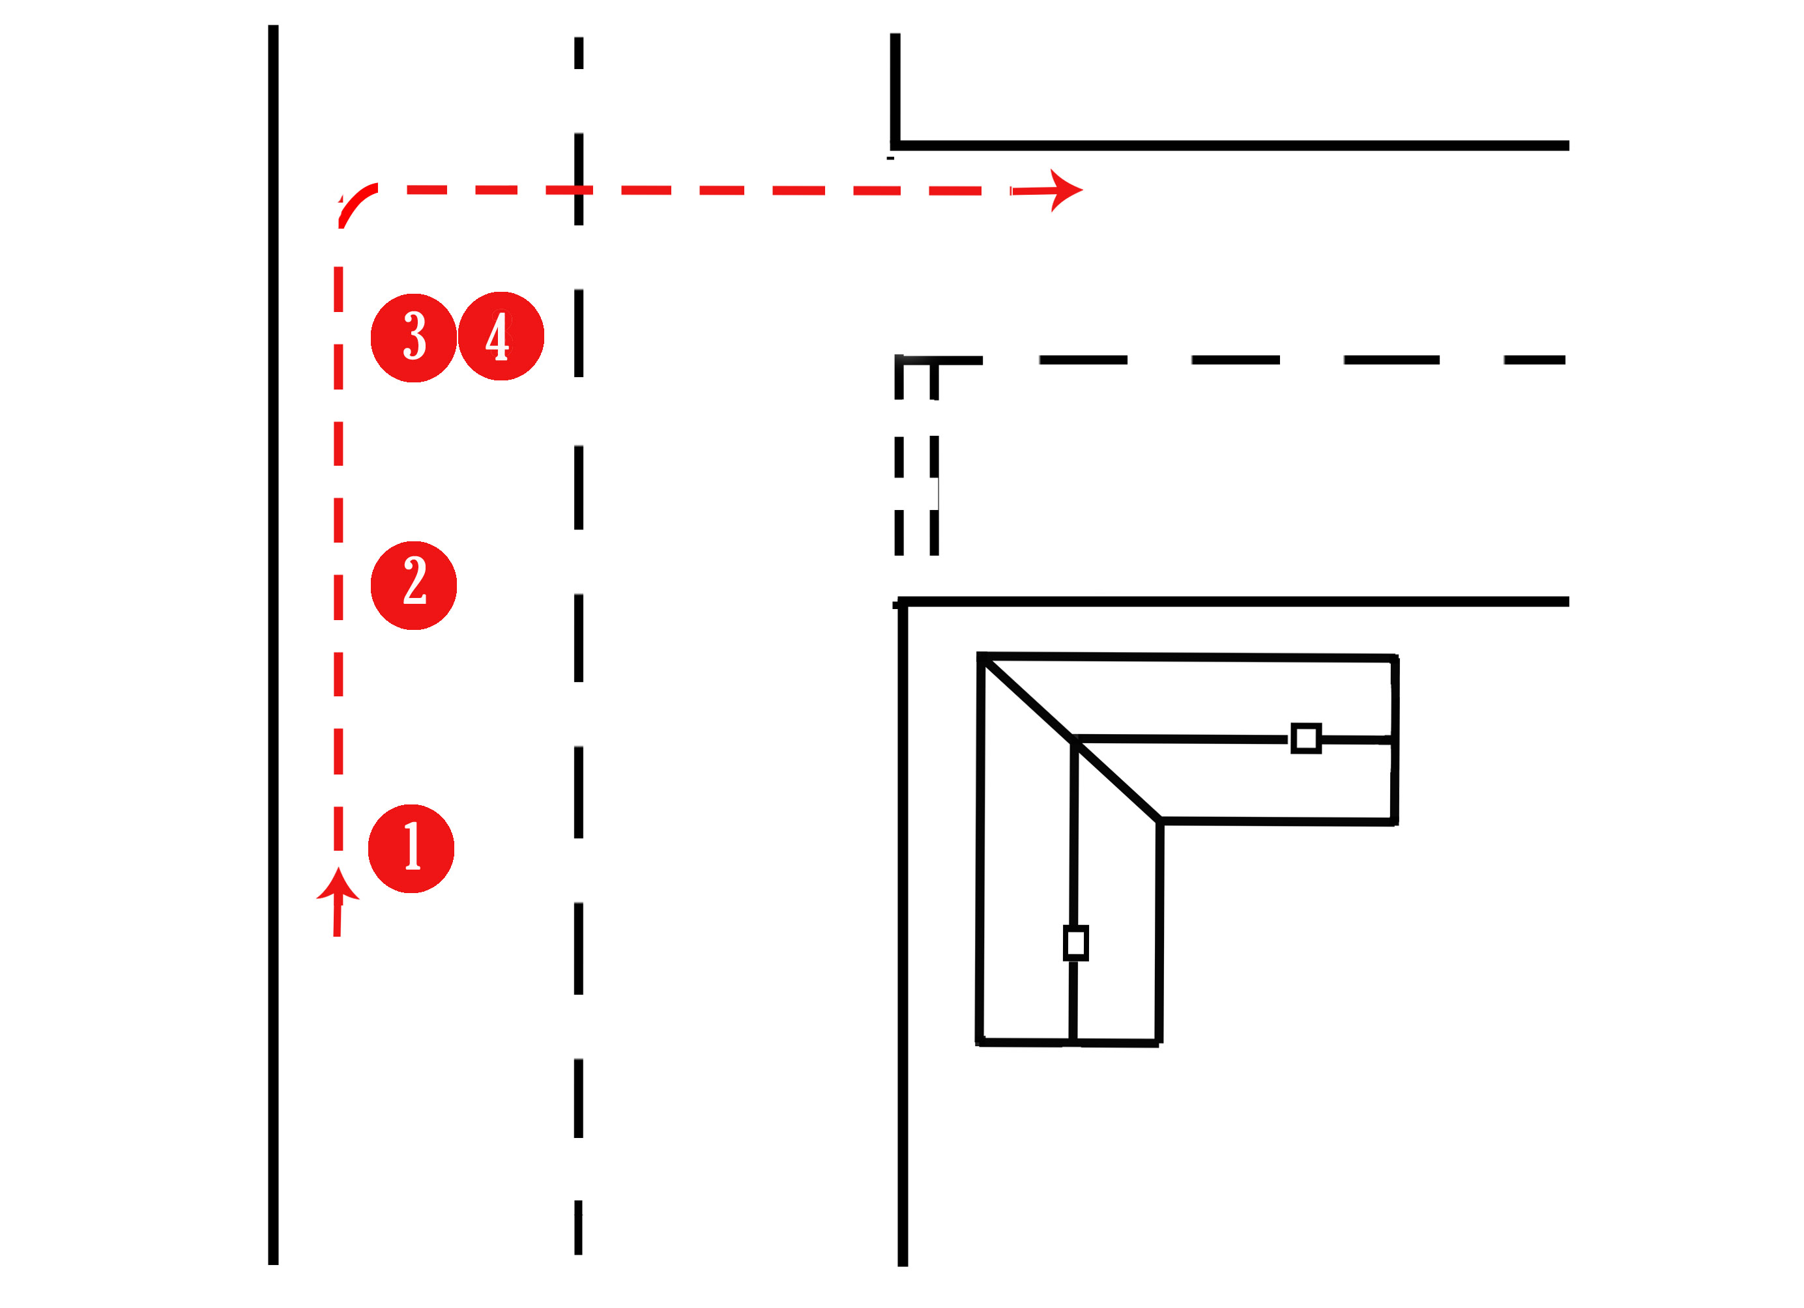
Manoeuvres
Right turn – major road into minor road
Right turn minor road into major road
4

Slide 13
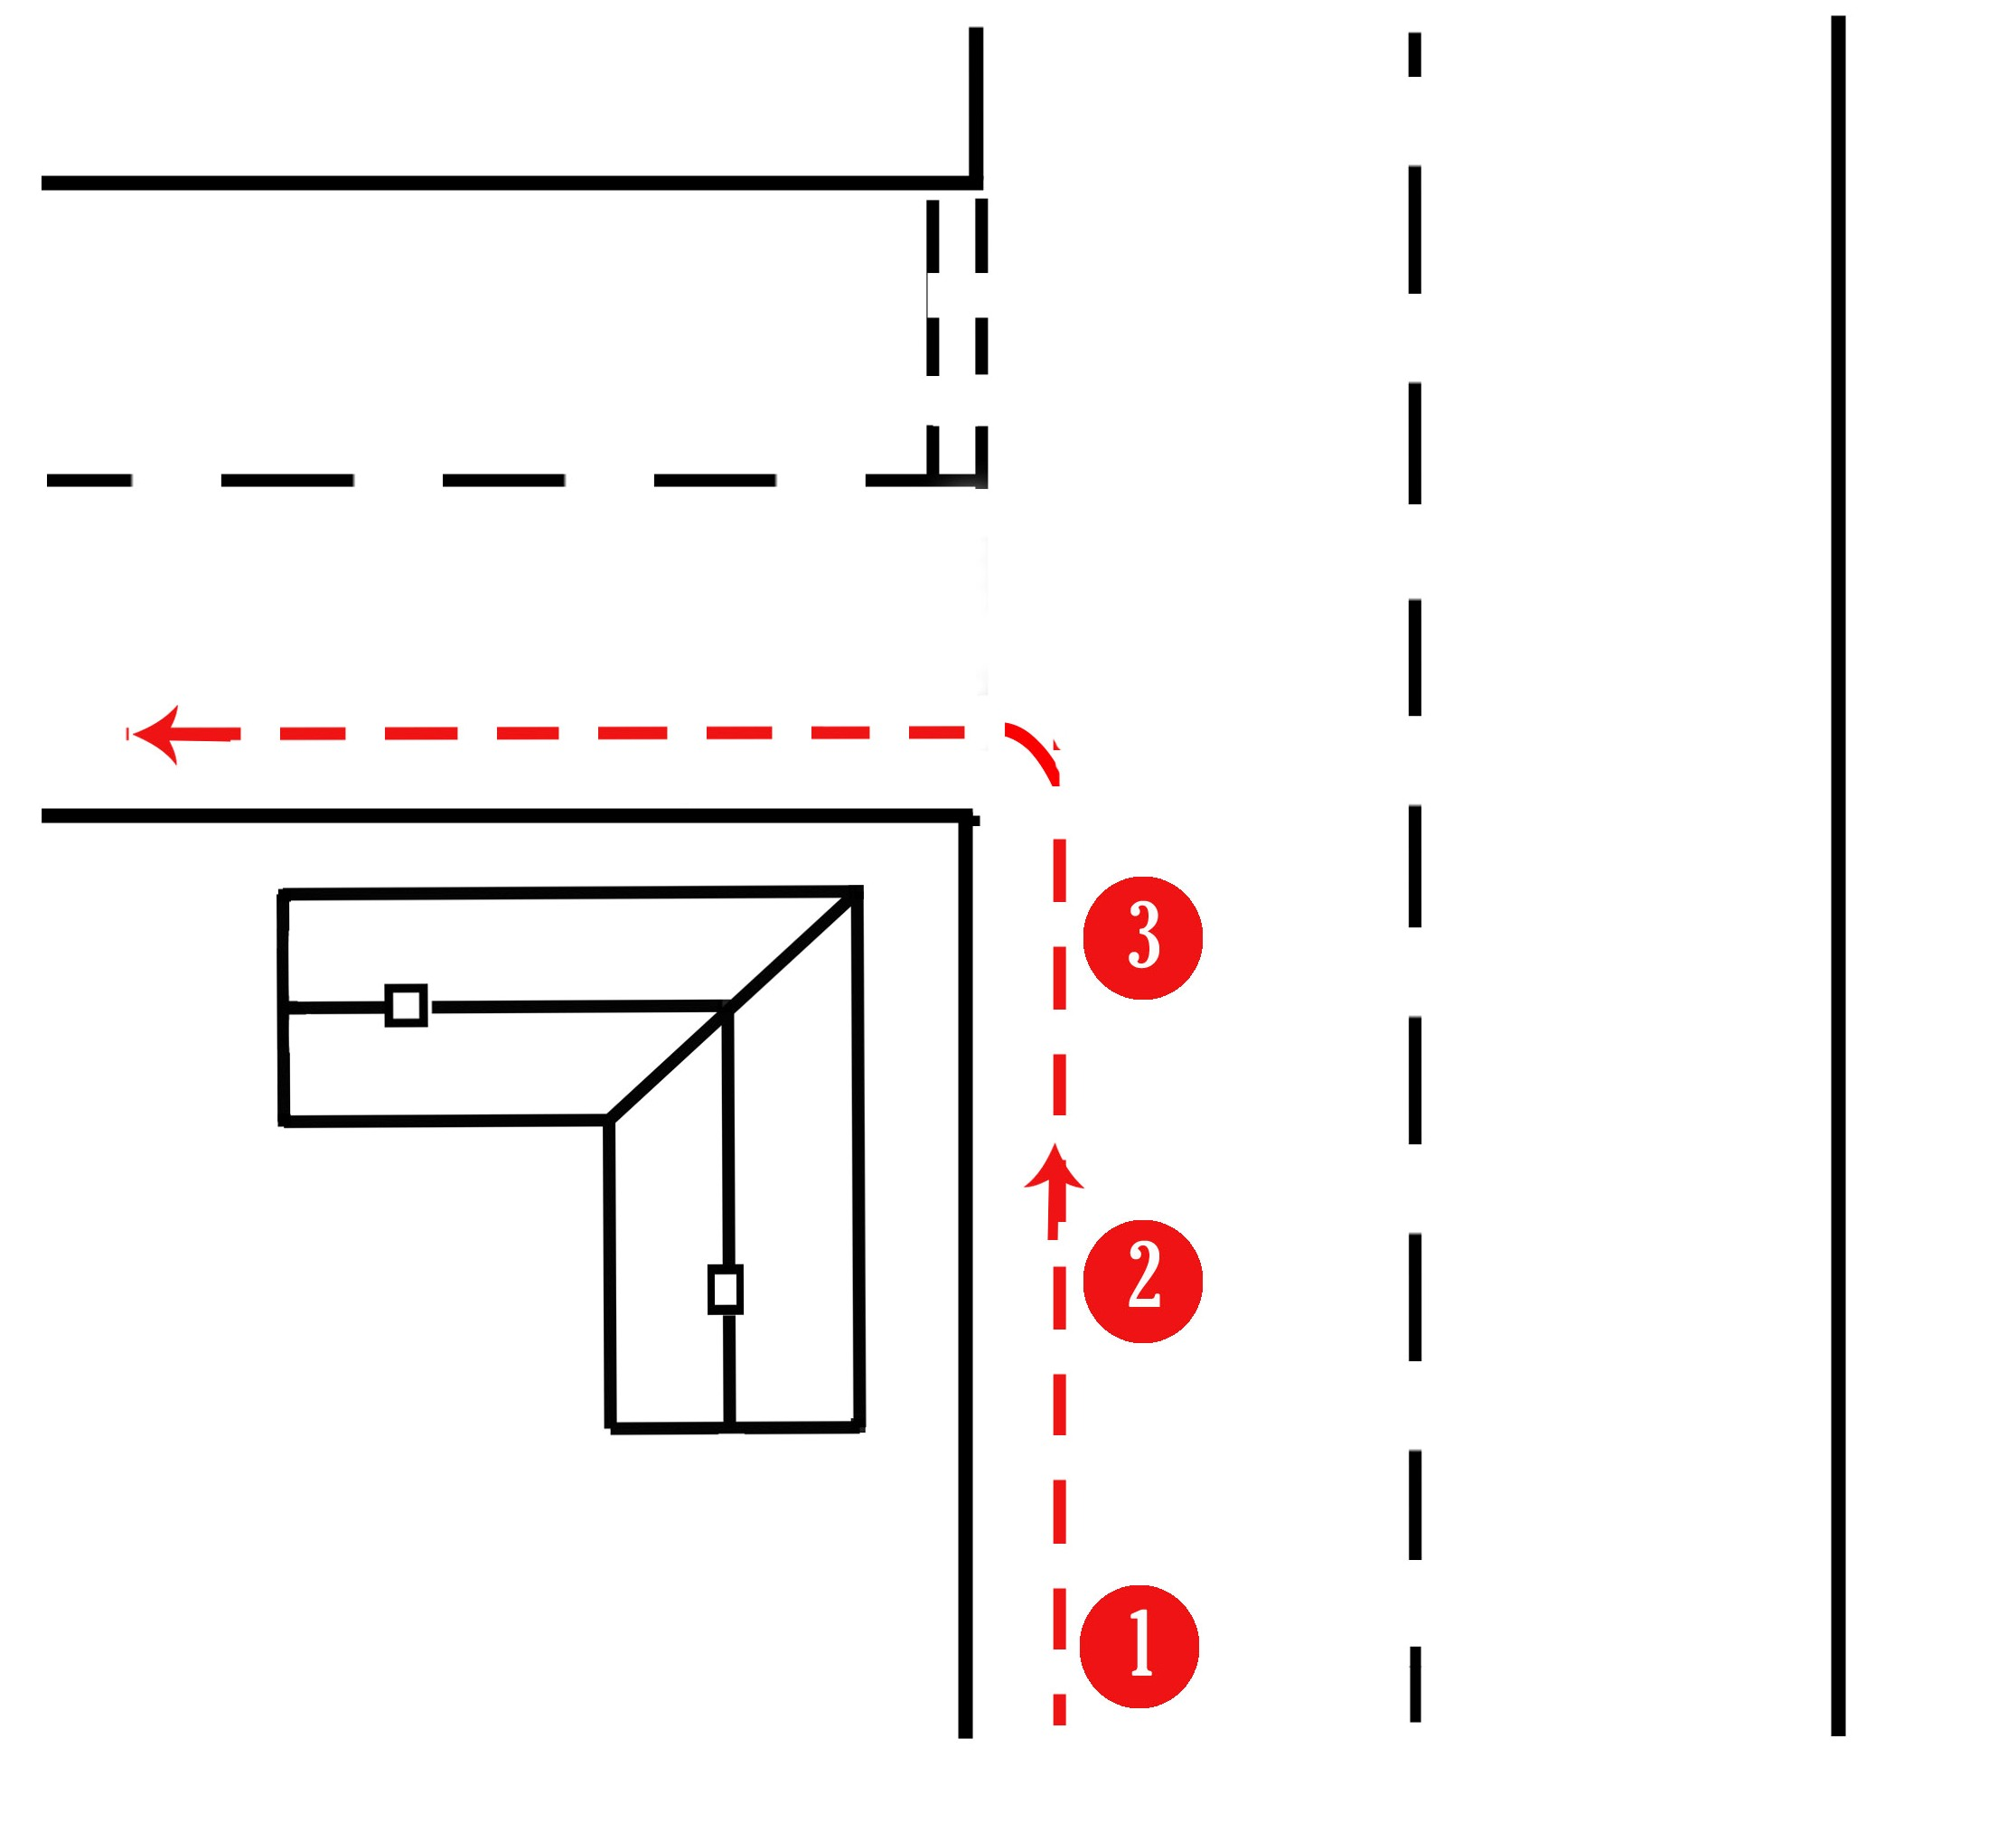

Manoeuvres
Passing a parked car or other hazard
Turn left major to minor road
4
4
3
2
1

Slide 14
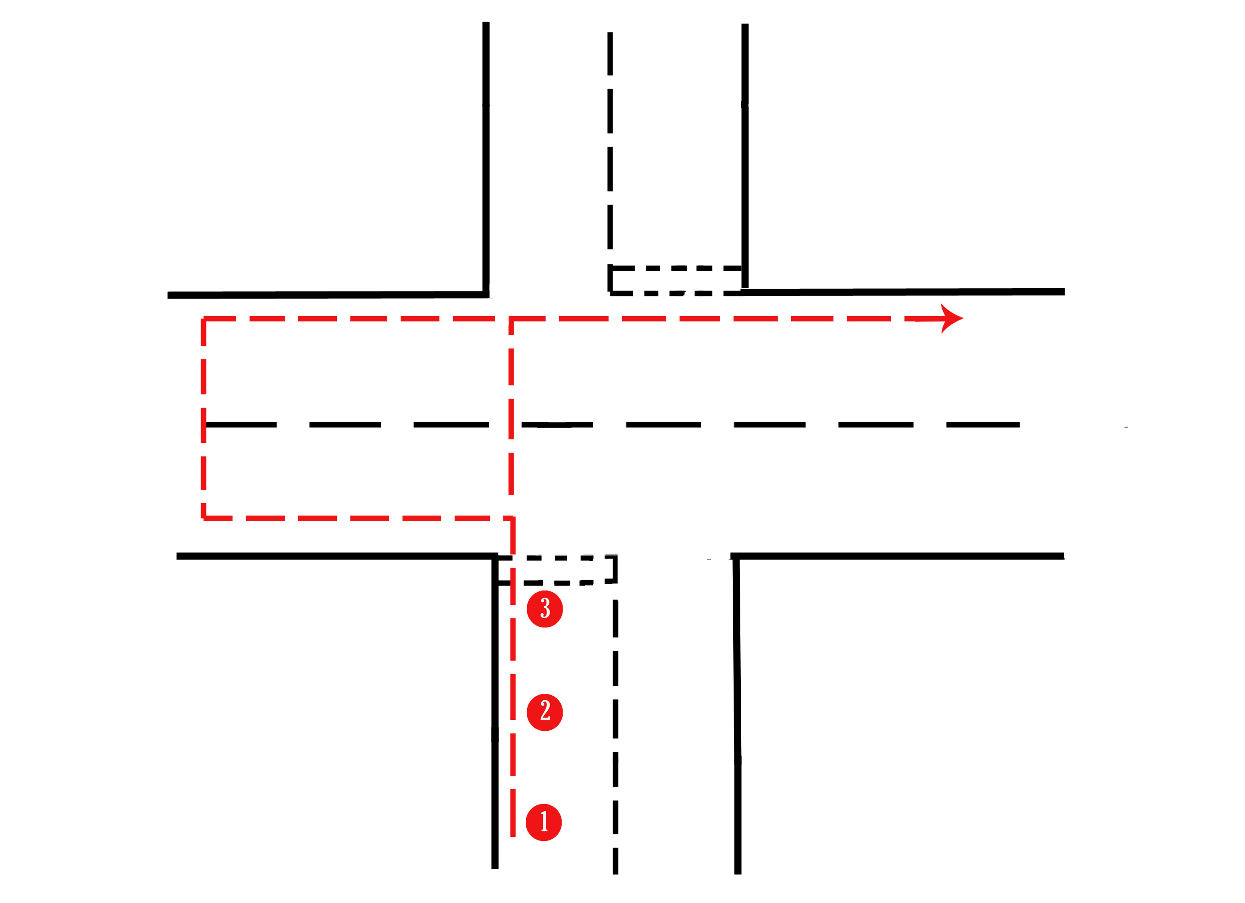
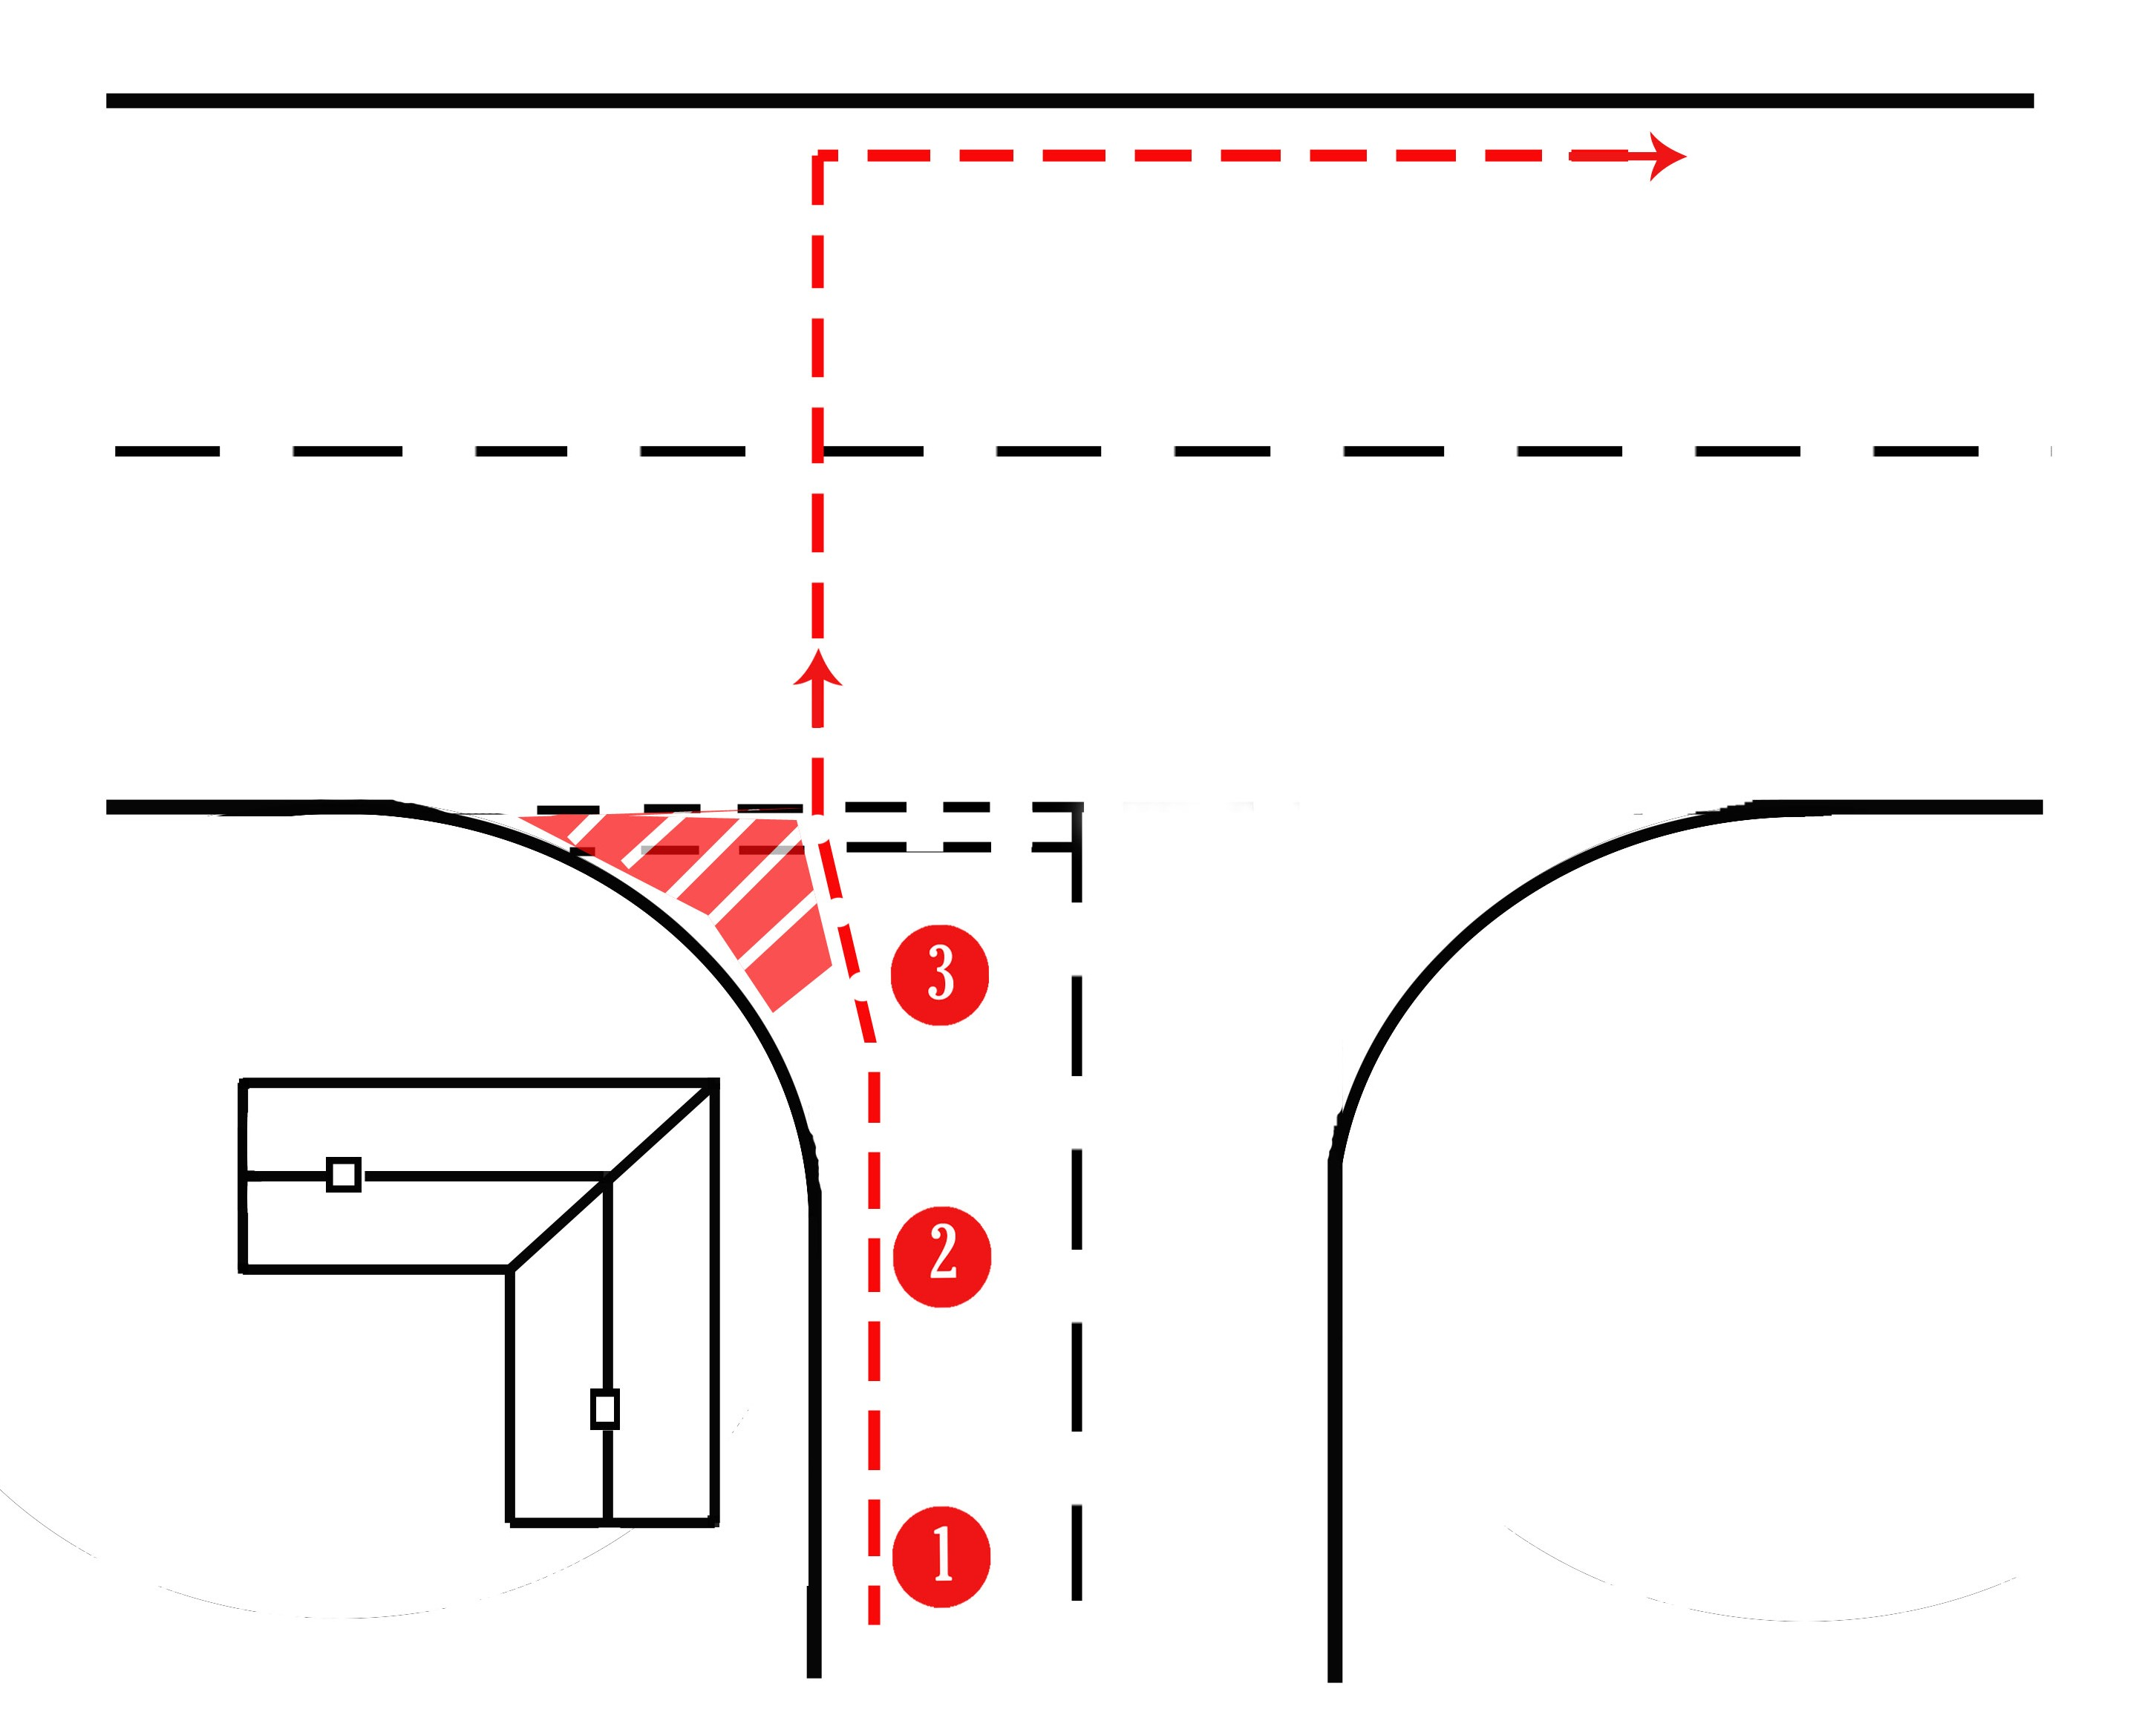
Manoeuvres
Flared junction
Crossroads
4
4
4

Slide 15

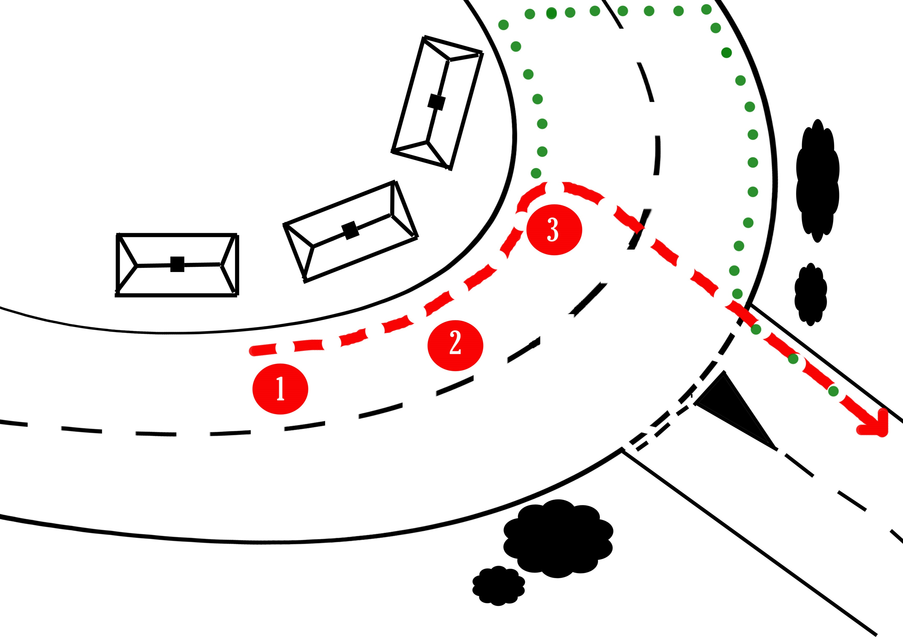
Manoeuvres
Blind bend
Roundabout
4
4

Slide 16
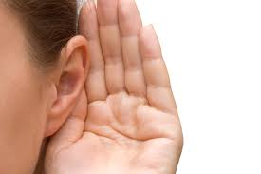


Training Aim 1 -establish Riding and Road Safety knowledge of coach
Recognise the need for different coaching styles
Finding out your student’s preferred learning style will you cater to your student’s individual needs.
While it may seem extra work, you’re more likely to see results quicker and keep your riders engaged.
Visual learners Kinaesthetic learners Auditory learners
Notes:
As a Ride Safe Trainer, you need to be able to deliver to a wide range of individuals within a group. Teaching models (and a rudimentary understanding of learning styles) help to make sure there is “something for everyone” in your delivery of concepts and techniques. Your sessions need to take place in a welcoming, inclusive, and supportive environment, where all participants are engaged and feel able to participate.
.

Slide 17

Training Aim 1 -establish Riding and Road Safety knowledge of coach
Ability to adapt your coaching style to support riders
Visual learners - Prefer to learn through seeing.
Auditory learners - Tend to learn best by listening.
Kinaesthetic learners - Learn best by doing.
Notes:
Visual learners
Prefer to absorb information best through seeing. This may be by asking them to look at their road route on a plan, looking at pictures or watching a video.
Auditory learners
Tend to learn best by listening and then talking about the information. This could be listening to a recording of them riding a simulated road route and talking it over you as their coach.
Kinaesthetic learners
Learn best by doing. They tend to use all their senses and have a hands-on approach

Slide 18

Training Aim 1 -establish Riding and Road Safety knowledge of coach
Planning skills
Check the underlying aims and objectives of the session.
Make sure you prepare to deal with changing
circumstances in a session, e.g. ability, horse type, venue.
Be aware of and comply with current legislation regarding children and vulnerable people. Identify learning outcomes or a clear purpose for the session, in order to help you to deliver progressive and structured sessions, with a clear direction.
Brief individuals and the group appropriately
Notes:
You should understand the impact on group motivation of a clear briefing and the group understanding the plan. The management of the whole session should then support this. Help develop a positive attitude towards Riding and Road Safety and lifelong participation within the BHS. It is important that you can demonstrate key skills and understand the roles that demonstration and instruction play in the learning process. It is also important that you understand that the participants need to practise and apply their learning.

Slide 19
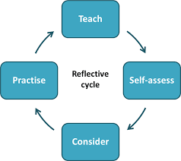
Training Aim 1 -establish Riding and Road Safety knowledge of coach
Understand the value of reflective practice
Notes:
The culture of reflective practice and striving for continual improvement is a fundamental feature in the development of all British Horse Society qualifications.
Evaluate the success of a session by assessing the appropriateness of the session aims and objectives, and the activities used to achieve them. You should understand the need for, and appropriate timing of, succinct and meaningful feedback that helps your riders develop. You need to understand that different people and situations may require varied feedback methods and be able to adapt your approach accordingly. A culture of reflective practice will enable you to review and modify your sessions and delivery. A simple ‘Plan-Do-Review’ cycle should be encouraged and implemented wherever possible.
Describe the experience - what happened? How did the session go? Any other thoughts you have about the situation?
Reflect - Were there any other factors that influenced the session? What have you learned from the experience?
Compare - How did the session match with your plans? Was the outcome expected or unexpected? What might have changed the outcome?
Reflective practice has huge benefits in increasing self-awareness,
It helps you to develop a better understanding of your riders.
Reflective practice can also help you to develop creative thinking skills, and consider different approaches for future training.
Reflective practice is, in its simplest form, thinking about or reflecting on what you do. It is closely linked to the concept of learning from experience, in that you think about what you did, and what happened, and decide from that what you would do differently next time.
The difference between casual ‘thinking’ and ‘reflective practice’ is that reflective practice requires a conscious effort to think about how your training was received and consider ways to enhance it for the future.

Slide 20

Training Aim 1 -establish Riding and Road Safety knowledge of coach
Be able to coach road signs and codes
Discuss Highway Code/The Rules of the Road
Explain relevant road markings, signs and symbols
Notes:
Rider specific sections of the Highway Code
Rule 49 – safety equipment 2). Rule 50 – visibility
Rule 51 - recommendations for riding after dusk 4). Rule 52 – check tack
Rule 53 – Strategies for riding on the road. 6).Rule 54 – Footpaths, pavements and cycle routes. 7). Rule 55 - roundabouts
Other relevant sections for riders
See pages 24-28 of Ride Safe guide for other rules that may affect riders.
Road markings
Give way to traffic on major road
Give way to traffic from the right on a roundabout
Stop at junction
Broken White Lines
Double white lines
Hatches/chevrons
Single and double yellow lines
Road signs and shapes
Common road signs as identified on page 29 of Ride Safe guide

Slide 21
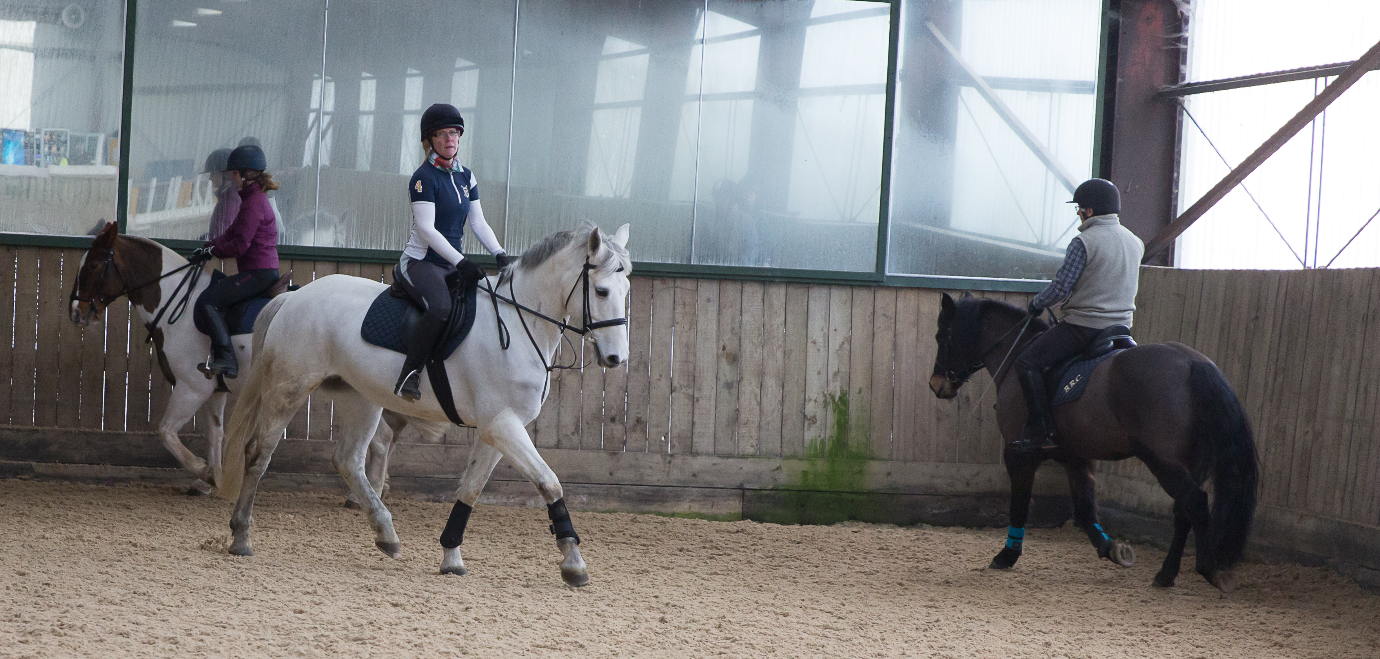
Training Aim 2 – Train groups of riders in an enclosed space
Rules of the school and awareness of other horses and riders
Keep at least one horse length between riders.
Give priority on the outside track to horses working at a faster gait.
Horses should pass left shoulder to left
shoulder.
If you must stop to adjust equipment move to the centre of the arena.
Notes:
Introducing concepts of passing left to left, never halting suddenly in front of another horse, being aware of other riders around you. Ensure you explain why. Explain the dangers of riding in a group like this, universally understood language in collecting ring (or possibly not!!), strategies to help people who struggle with left and right.

Slide 22
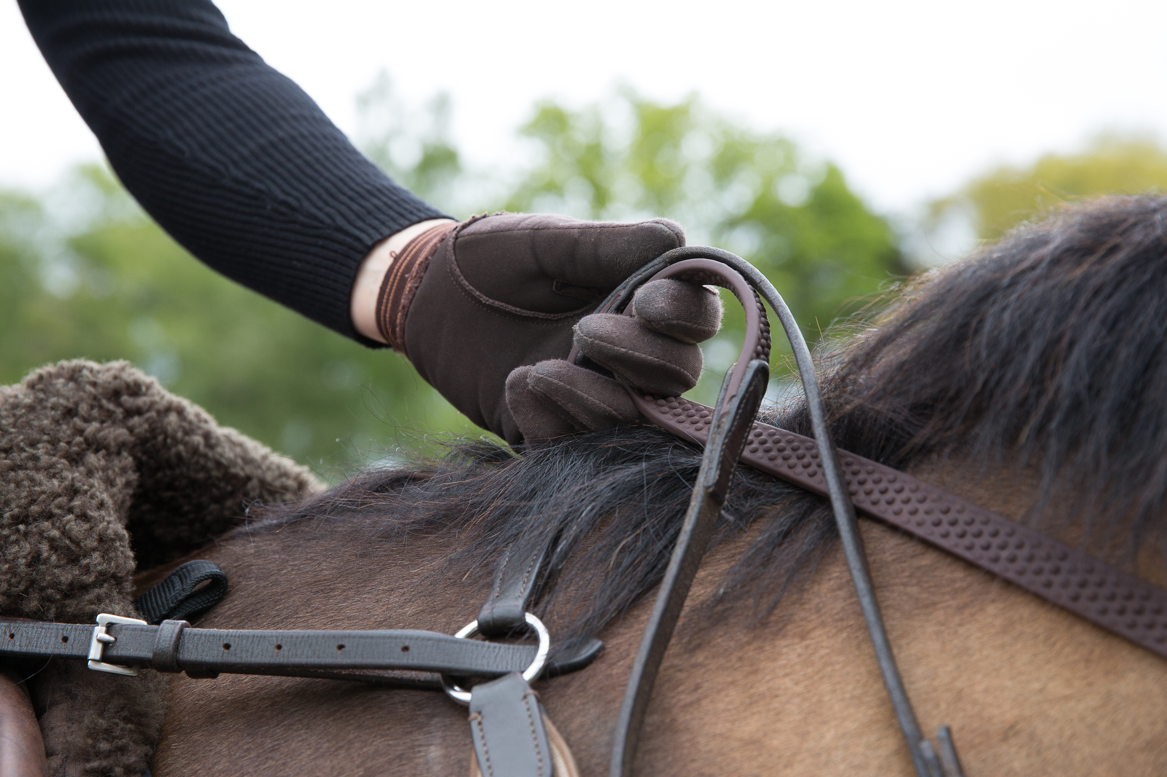
Training Aim 2 – Train groups of riders in an enclosed space
Riding with the reins in one hand
Explain why this is taught and why it is a skill all riders should have.
Notes:
Teach the group to ride with reins in one hand. Explain why this is taught and why it is a skill all riders should have.
Discuss different methods of holding reins, what the horse needs to understand first, common issues, simple exercises.

Slide 23
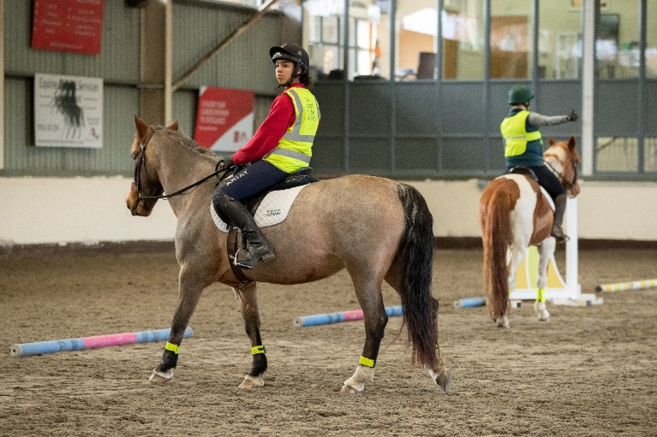
Training Aim 3 – prepare riders to ride safely on the road
Prepare riders to ride safely on the road
Control of horse including hand signals on a simulated road route
Different junctions/priorities
Emergency dismount procedures
Passing hazards
Notes:
Understand road signs and symbols
Be able to set up simulated routes using poles, dressage boards, or similar. Train riders on their feet through the set-up road route, complete with hazards to pass and area suitable for dismount and lead as if on the road. Ensure the message of why we suggest riding around a hazard in a certain way is conveyed. Discuss types of junctions (non-drivers may not know) and what need to be aware of, what types of things can affect where riders position horse on road,
Different road layouts (inc flared junctions). Major and minor roads.
Tuition on carrying out an emergency dismount, when it is appropriate

Slide 24
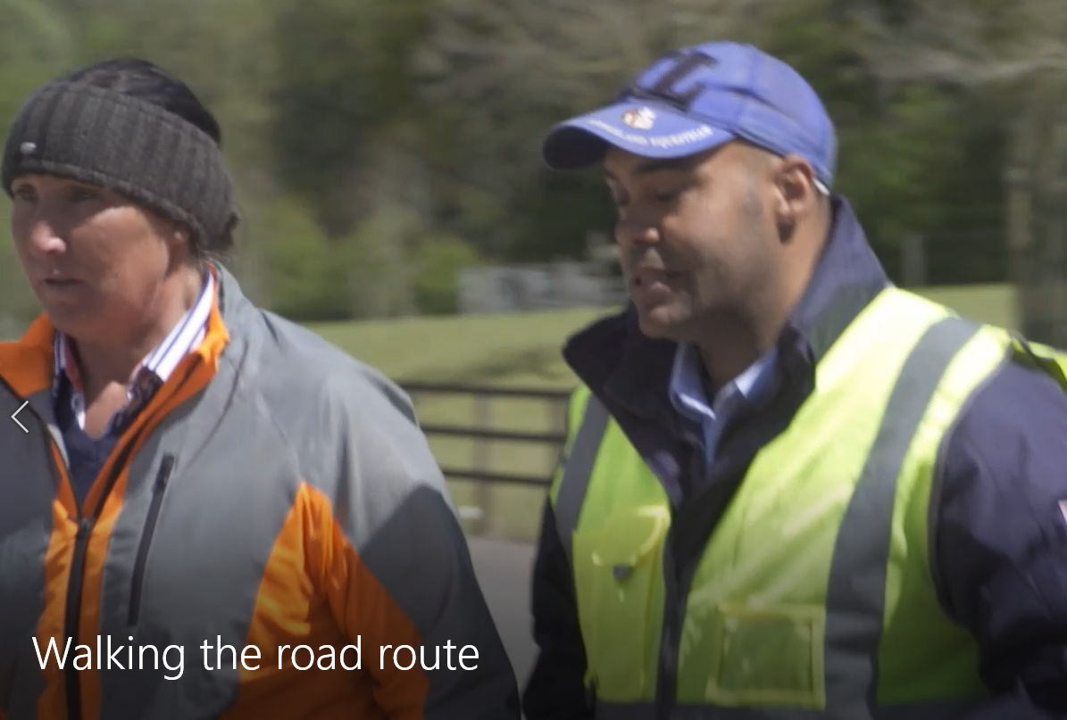
Training Aim 4 - Train riders to ride safely on the road
Establish a suitable road route(s)
  Trainers to walk to find suitable routes that include left, right turns with some traffic.
  How to try and find a suitable place to ride at each venue you are training at.

Slide 25
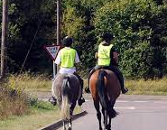
Training Aim 4 - Train riders to ride safely on the road
Walk road route(s) with riders (on foot and on horses).
Support riders riding the route
Discuss different types of hazard and how to deal with them
When to carry out emergency dismount
Establish protocols for riding side by side (not in Ireland).
Notes:
Trainers to walk to find suitable routes that include left, right turns with some traffic. How you can try and find a suitable place to ride at your own yard?
Trainer walking with riders mounted along route highlighting potential hazards and situations to be aware of. Maybe show different types of hazard so its not necessarily a big thing like parked car, could be children on scooters, dog in garden, wrong coloured leaf, unless you have a ‘reactive’ horse you might never consider things like this a hazard
Riding side by side and one behind another (Ireland), where appropriate and safe. and why this might be suitable
Trainer walking with riders mounted along route highlighting potential hazards and situations to be aware of.
Maybe show different types of hazard so its not necessarily a big thing like parked car, could be children on scooters, dog in garden, wrong coloured leaf, unless you have a ‘reactive’ horse you might never consider things like this a hazard

Slide 26
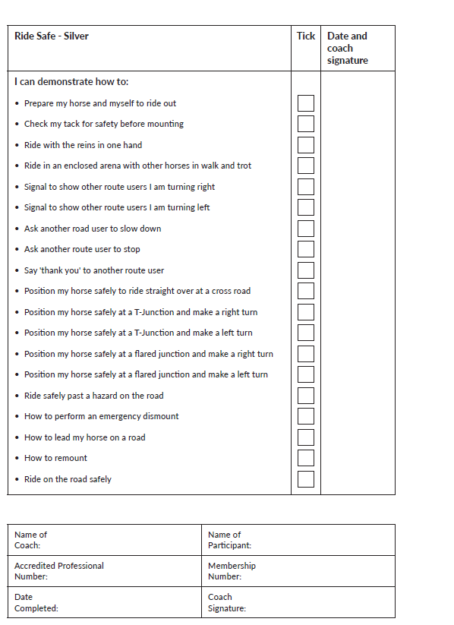
Training Aim 5 –sign off Bronze and Silver Challenge booklets
Observe riders completing all sections.
When observing road route, step back and make sure the rider is independently competent and safe!
Remember – it is your reputation behind this award.
Notes:
It is vitally important that the trainer becomes an ‘assessor’ for the road route section of the booklet.
If the rider is not competent and safe they must NOT sign them off, but regroup, retrain them and reassess at another opportunity.

Slide 27
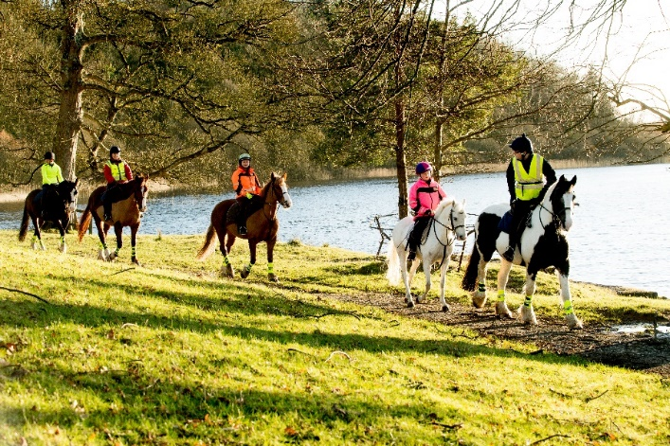
Training Aim 6 – review own learning
Riding safely in alternative environments
Setting up training
Promoting training
Costs and sources of funding
Value to coaches in being an APC
Notes:
Discussion about riding safely in other environments (fields/beaches/moorland/forests).
Next steps – how to set up training courses, use of Challenge Award lesson plans. Mention gold and platinum CA
Promoting training through social media/coffee mornings/at riding schools/clubs.
Costs and potential sources of funding to support training (local committees/fund raising etc)
Value to coaches of being an APC.
Discuss how to deal with confrontation, loose dogs etc. Since lockdown there has been a huge increase in the number of walkers and dogs off leads and it has made hacking more difficult.
2026 save your route campaign

Slide 28
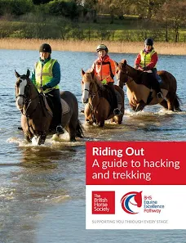
Associated Awards
How the rider can progress onto Gold and Platinum Challenge Award
Ride Leader Qualifications

Slide 29
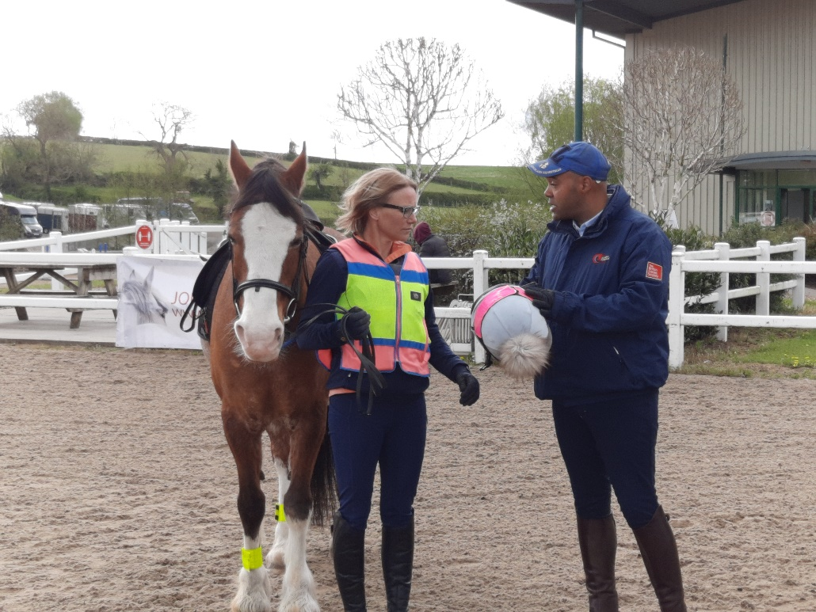
To Find Out More……..
Contact the BHS Education Team on
024 76 840508
Email us on education@bhs.org.uk
Look on our website www.bhs.org.uk
Access the Accredited Professional Hub

